Slide 1

Sharadchandra Pawar College of Engineering and Technology, Someshwarnagar
Department of Computer Engineering
Presentation on:
“Diagnosing Respiratory Conditions Via Lung Sounds using CNN-LSTM”
Presented by :- Rohit Pawar.(Co-437) Aditi Raut.(Co-441) Sneha Jadhav.(Co448)
Guide Name:-Prof.Shah.S.N.

Slide 2
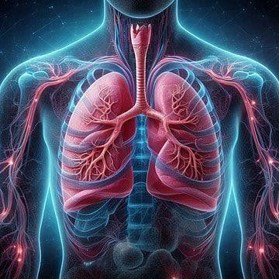

Diagnosing Respiratory Conditions Via
Lung Sounds using CNN-LSTM

Slide 3
Contents
Abstract
Introduction
Motivation
Objective
Literature Survey
Problem Statement
Existing System
Block Diagram
UML Diagrams
Hardware & software Requirement
Advantages
Disadvantages
Application
References

Slide 4
Abstract
In order to analyze respiratory sounds on a computer, we developed a cost-effective and easy-to-use Algorithm that can be used with any device.
We employed two types of machine learning algorithms; Gammatone cepstrum coefficients(GTCC) & Short-Time Fourier Coefficients (STFC) features in a Convolutional Neural Network with a CNN-LSTM algorithm.
We prepared four data sets for CNN-LSTM algorithm to classify respiratory audio:
Healthy versus pathological classification; (2) rale, rhonchus, and normal sound classification; (3) singular respiratory sound type classification; and (4) audio type classification with all sound types.

Slide 5
Introduction
Lung Auscultation: A widely used diagnostic method by pulmonary experts to assess the respiratory system’s condition.
Detection of Lung Sounds: Various sounds are heard when examining different areas on the front and back of the chest.
Significance of Lung Sounds: They reveal anatomical issues in the lungs and offer reliable insights into respiratory health, making them a valuable tool for diagnosing respiratory disorders.
Global Impact: According to the World Health Organization (WHO), around 10 million people die annually from respiratory diseases.

Slide 6
Motivation
The aim of this project is to classify the Lung Sounds based on the different features present in that, also have to Classify the disease for better performance.

Slide 7
Objective
Develop a Cost-Effective and Accurate System: Create a system for classifying lung sounds that is affordable, precise and requires minimal computational resources.
Automate Respiratory Sound Analysis: Address the increasing demand for automated tools due to the high global burden of respiratory diseases, improving accessibility and efficiency in diagnosing respiratory conditions.
Medical professionals looking to quickly assess respiratory conditions in clinical and remote settings.
Training datasets and improving machine learning models for more accurate respiratory sound classification.

Slide 8
Literature Survey
Ref No | Title of Paper | Authors Name | Publication | Remark
1 | Investigating into segmentation methods for diagnosis of respiratory diseases using adventitious respiratory sounds | Liqun Wu, Ling Li | 2020 IEEE International Conference on Bioinformatics and Biomedicine (BIBM) | Examines segmentation techniques and machine learning for respiratory disease diagnosis, achieving 88% accuracy​.
2 | A Respiratory Sound Database for the Development of Automated Classification | B.M.Rocha, D. Filos, L. Mendes, I. Vogiatzis, | IFMBE Proceedings | Introduces a large database for classifying respiratory sounds in clinical and non-clinical settings
3 | Automated Detection of Pulmonary Diseases From Lung Sound Signals Using Fixed-Boundary-Based Empirical Wavelet Transform | Rajesh Kumar Tripathy, Shaswati Dash, Adyasha Rath, Ganapati Panda, Ram Bilas Pachor | IEEE Sensors Letters, Vol. 6, No. 5, May 2022 | Proposes a method using wavelet transforms and machine learning to detect pulmonary diseases with high accuracy​

Slide 9
Problem Statement
Respiratory diseases are a leading cause of death globally, and traditional lung auscultation is subjective and limited. Current diagnostic algorithms are costly and complex, lacking real-time performance. There is a need for an efficient, low-cost, and accurate system to classify lung sounds automatically, improving early diagnosis and treatment.

Slide 10
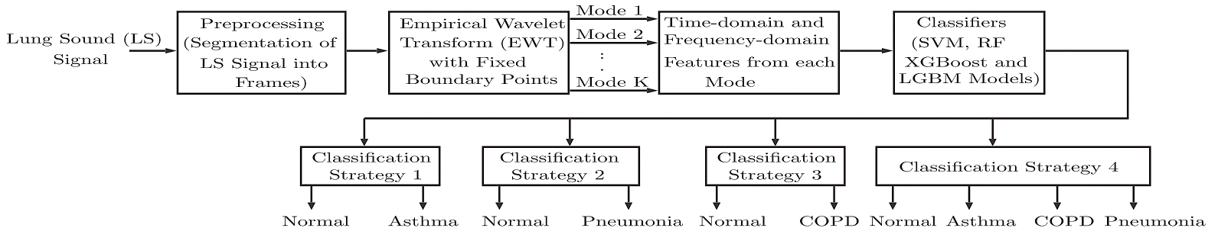
Existing System

Slide 11

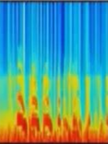
BLOCK DIAGRAM
Pre-processing
Lung sound
Re-sample at 4kHz
Temporal
Snippet
generation
DFT based
baseline
wander
removal
Amplitude
normalization
Classification
Log scaled melspectrogram
Asthma
Pneumonia
CNN+LSTM
Tuberculosis
Pleural Effusion
Bronchitis
Atelectasis
Pulmonary Edema
COPD

Slide 12
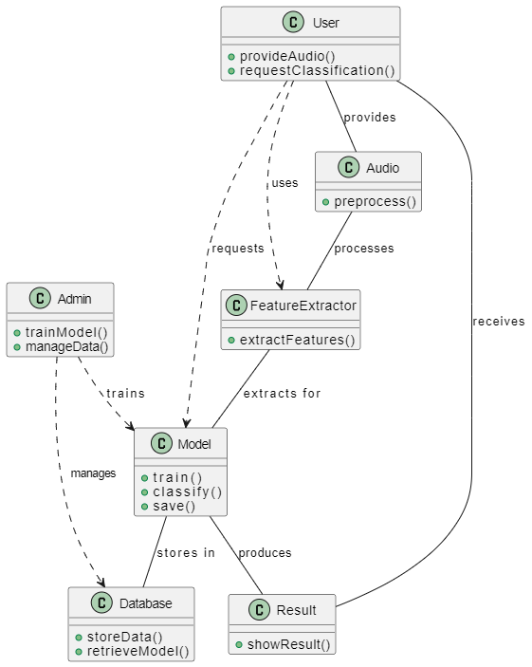
CLASS DIAGRAM

Slide 13
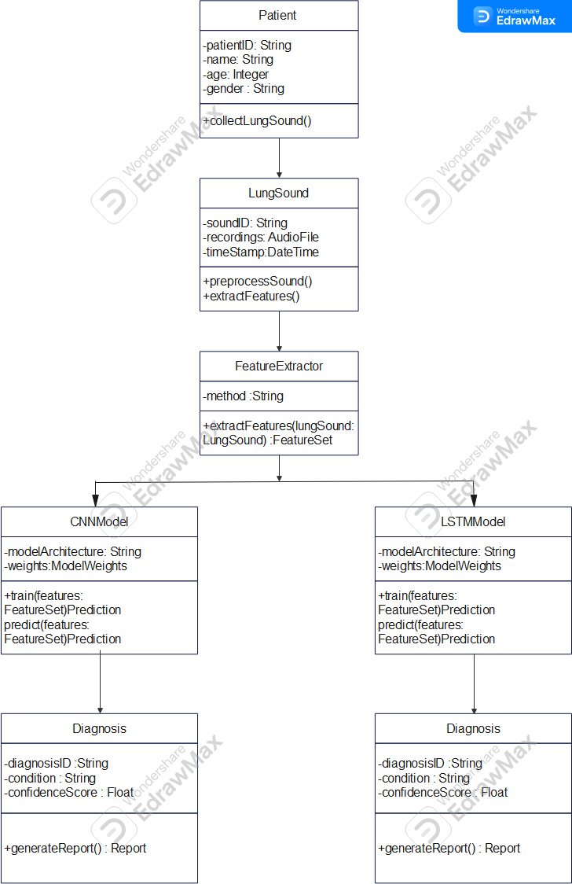
Object Diagram

Slide 14
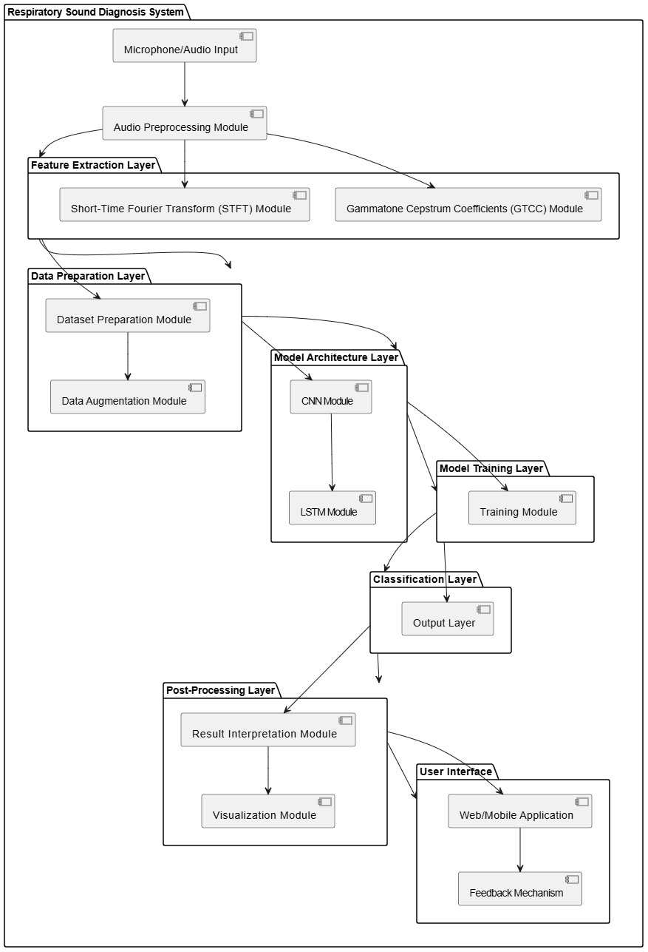
Component Diagram

Slide 15
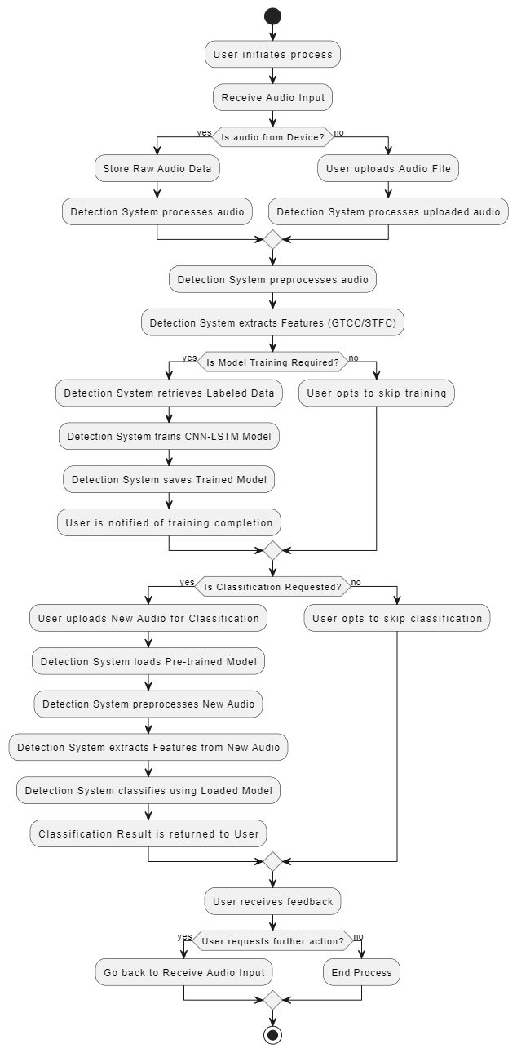
ACTIVITY DIAGRAM

Slide 16
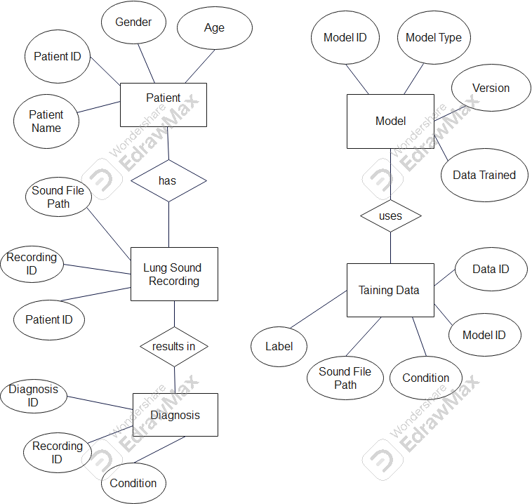
ER Diagram

Slide 17
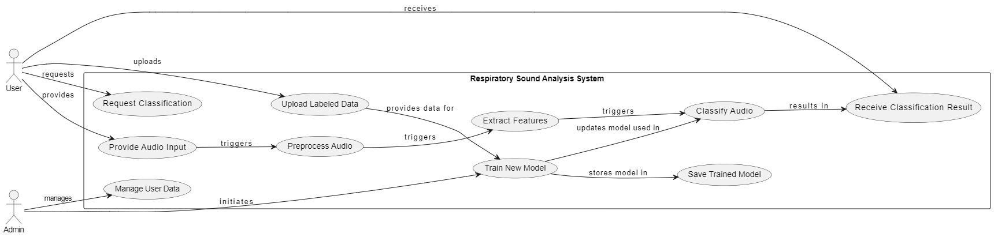
USE CASE DIAGRAM

Slide 18
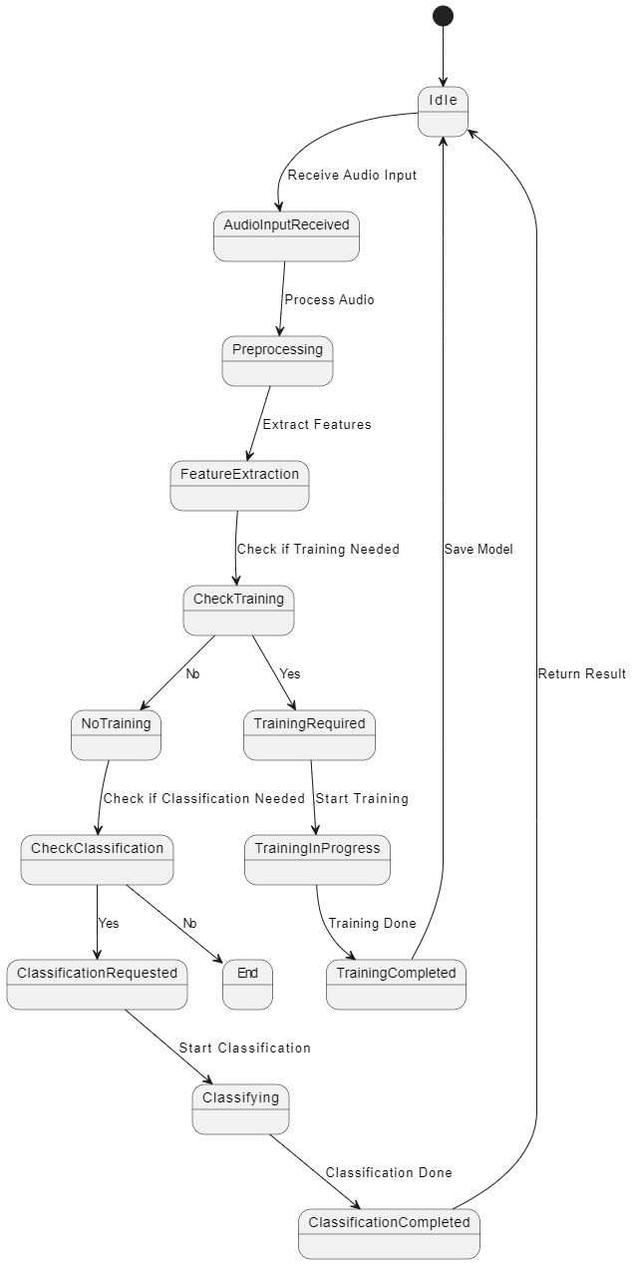
State Diagram

Slide 19
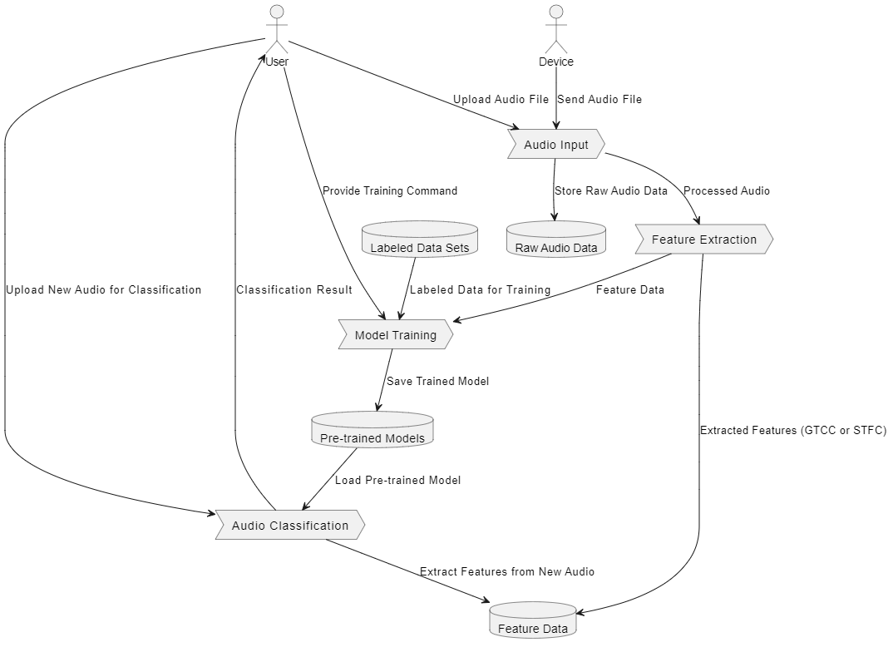
Dataflow Diagram

Slide 20
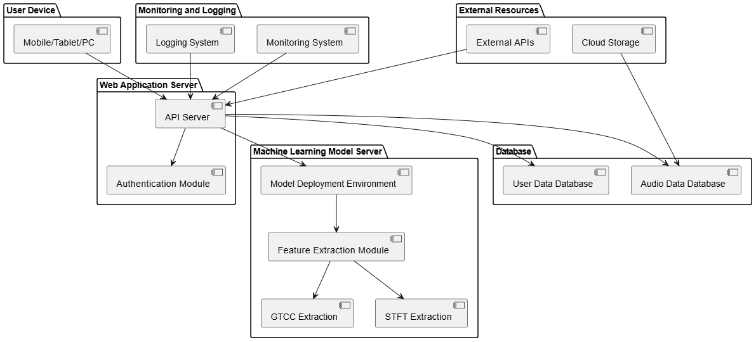
Deployment Diagram

Slide 21
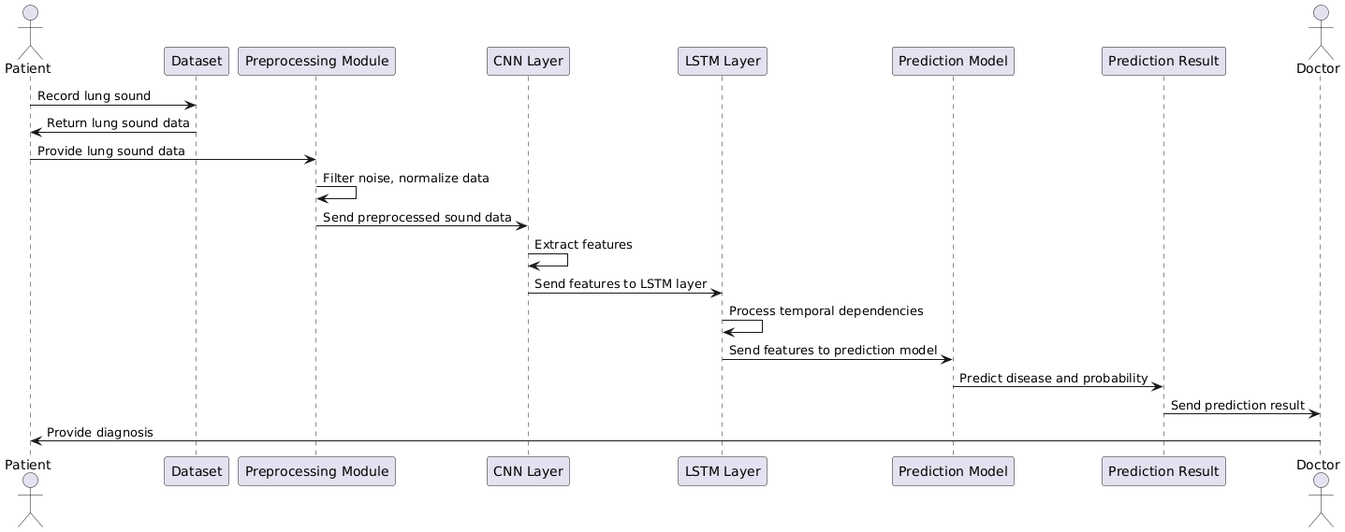
Sequence Diagram

Slide 22
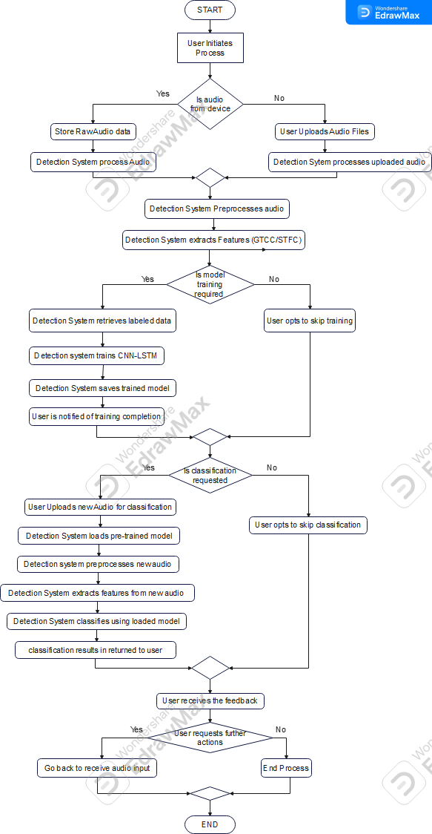
Flowchart Diagram

Slide 23
Component description
CNN-LSTM Architecture: A hybrid architecture that combines convolutional neural networks (CNN) for spatial feature extraction from sound spectrograms and long short-term memory (LSTM) layers to capture temporal patterns in lung sound sequences.
Pre-processing: Lung sounds are pre-processed using techniques such as log-scaled Mel spectrograms and temporal snippet generation to enhance the model’s efficiency.
Feature Extraction: Key features extracted include Gammatone Cepstrum Coefficients (GTCC) and Short-Time Fourier Coefficients (STFC), which provide critical insights into the patterns of lung sounds.

Slide 24
Hardware & Software Requirement
Hardware Requirements:
Hard Disk: Greater than 500 GB
RAM: Greater than 4 GB
Processor: I3 and Above
Software Requirements:
Front End – Anaconda IDE
Backend – SQL
Language – Python 3.8

Slide 25
Advantages
Improved Accuracy
Scalability and Flexibility
Reduced Human Error
Low cost

Slide 26
Disadvantages
Limited Clinical Validation.
Generalization Issues.
Computational Constraint

Slide 27
Application
Clinical Diagnostics: Can be used by healthcare professionals for quick, real-time lung sound analysis in clinical settings, helping in early detection of conditions like pneumonia, asthma, COPD, and tuberculosis.
Remote Monitoring: The system is suitable for remote healthcare applications where lung sounds can be classified without the need for expensive equipment.
Medical Research and Training: This system can be used for improving machine learning models and datasets for respiratory condition classification, aiding in research and educational training for medical professionals

Slide 28
References
Tripathy, R. K., Dash, S., Rath, A., Panda, G., & Pachori, R. B. (2022). "Automated Detection of Pulmonary Diseases From Lung Sound Signals Using Fixed-Boundary-Based Empirical Wavelet Transform." IEEE Sensors Journal [12+source].
Wu, L., & Li, L. (2020). "Investigating into segmentation methods for diagnosis of respiratory diseases using adventitious respiratory sounds." Proceedings of IEEE [6+source].
Rocha, B. M., et al. (2019). "A Respiratory Sound Database for the Development of Automated Classification." IFMBE Proceedings [5+source].

Slide 29
Thank you

